Slide 1
Community Data Management System (CDMS) & Climate Model Output Rewriter (CMOR)
Task |  | R&D Area
1.1 |  | Data Management
1.2 |  | User Interface and Search
1.3 |  | Hardware & Network
1.4 |  | Data Transfer
1.5 |  | Installation (Containerized)
1.6 |  | Authentication & Authorization
1.7 |  | Federation
1.8 |  | Quality Control & Assurance
1.9 |  | Replication
1.10 |  | Distributed Search
1.11 |  | Metrics
1.12 |  | User Notification
1.13 |  | Long-tail Publication
1.14 |  | Distributed Computation
1.15 |  | Data Citation
2.1 |  | Provenance Capture
2.2 |  | Workflow
2.3 |  | Dynamic Resources
2.4 |  | In situ Analysis
2.5 |  | Machine Learning
2.6 |  | UQ
2.7 |  | Analytical Modeling
2.8 |  | Mobile Apps
Current capability status:
 | Usable
 | Prototype
 | Research activity
Denis Nadeau
Lawrence Livermore National Laboratory
2017 Triennial Project Review, Potomac, MD
June 8 – 9, 2017
LLNL-PRES-731858-DRAFT
This work was performed under the auspices of the U.S. Department of Energy by Lawrence Livermore National Laboratory under Contract DEAC52-07NA27344

Slide 2
Outline
ESGF Data Provider Files
Climate Model Output Rewriter (CMOR) and ESGF
Why is it needed?
Control Vocabulary database (metadata)
Publish Data to ESGF
Community Data management System (CDMS)
What is it?
Adding parallelism to data processing and file I/O
Updating and adding efficiency

Slide 3
ESGF needs CMOR 3.2
244.
275.2
229.4
282.4
288.5
265.3
270.1
256.3
276,4
298.3
288
298
245.
298.4
276.2
294.1
302.3
36
302
225.
287.3
284.12
288.4
303.2
34.6
Raw input data
303
49
225.
287.3
284.1
288.4
303.2
22.4
3.6
34.5
67
284.80
298.3
300.0
308.9
303.7
24
53
9.81
33.2
273.1
286.
286.40
275.54
263.33
7.2
14.1
34
298.4
303.9
285.0
283.3
294.2
25.6
294.3
312.77
284.3
289.7
297.3
12.4

Slide 4
ESGF needs CMOR 3.2
CMIP6
&
Climate Format Convention
Air Temperature (kelvin)
Height (meters)
90
244.
275.2
229.4
282.4
288.5
45
265.3
270.1
256.3
276,4
298.3
288.5
25
298
-45
245.
298.4
276.2
294.1
302.3
36
20
-90
302
225.
287.3
284.2
288.4
303.2
34.6
49
15
22.4
Latitude (degrees)
225
287.3
284.1
288.4
303.2
303
3.6
Rewrite
303
67
10
284.80
298.3
300.0
308.9
303.7
24
53
263
33.2
5
273.1
286.
286.40
275.54
263.33
7.2
294
34
298.4
303.9
285.0
283.3
294.2
25.6
294.3
312.77
284.3
289.7
297.3
12
-180
-90
0
90
180
Longitude (degrees)
0
6
9
12
15
…
Time (hours since 2010-01-01)
netCDF4 output file

Slide 5
Control Vocabulary (CMIP6)
Use of CMIP6 metadata in ESGF Search Engine
CMIP6 Global Metadata
// global attributes:
:Conventions = "CF-1.6 CMIP-6.0" ;
:activity_id = "ISMIP6" ;
:creation_date = "2016-11-18T00:12:33Z" ;
:data_specs_version = ”01.00.10" ;
:description = "Pre-industrial control simulation that
includes interactive ice sheets" ;
:experiment = "preindustrial control with interactive
ice sheet" ;
:experiment_id = "piControl-withism" ;
:external_variables = "areacella" ;
:source_type = "AOGCM ISM AER" ;
:sub_experiment = "none" ;
:sub_experiment_id = "none" ;
:table_id = "6hrLev" ;
:variable_id = "ta" ;
:variant_label = "r11i1p1f1" ;
…

Slide 6
Publishing to ESGF with CMOR
Workflow
{
"Header": {
"data_specs_version": “01.00.10",
"table_id": "Table Amon“
},
"variable_entry": {
"ccb": {
"modeling_realm": "atmos",
"units": "Pa",
}
}
Centre for Climate Prediction and Research, UK
XML
Table
JSON
Tables
Create
Write model
output files
Rewrite
variables
Publish Data
Write
ESGF
GCM Run
CMOR3
CMIP6 & CF-1
Files
PrePARE
Load Table
Disk
(Native
format)

Slide 7
Community Data Management System (CDMS)
Enable authentication (MyProxyClient) to access ESGF data.
Add Oauth 2 authorization framework to ESGF
Can read different data format used by scientists
netCDF, hdf4, OPeNDAP, Grads…
Used by many projects including:
CMOR (PrePARE)
PCMDI Metric Package (PMP)
Community Data Analysis Tools (CDAT)

Slide 8
Community Data Management System (CDMS)
Future
Accelerate processing time in CDMS for ESGF
Just-In-Time (JIT)
Multiprocessing
Parallel I/O
Thread 0
numba
netCDF4
Thread 1
CDMS
Function
Machine Code
Combine results
Thread 2
Write to
File
LLVM-PY
Thread 3
Scheduler

Slide 9
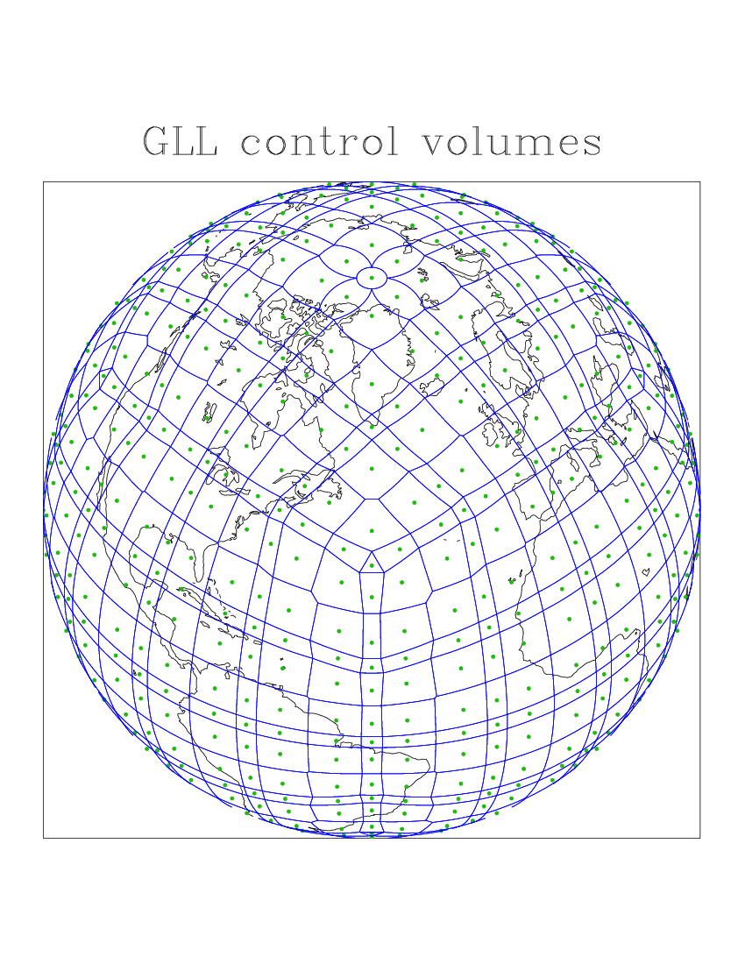
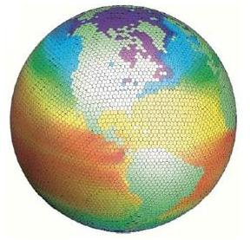
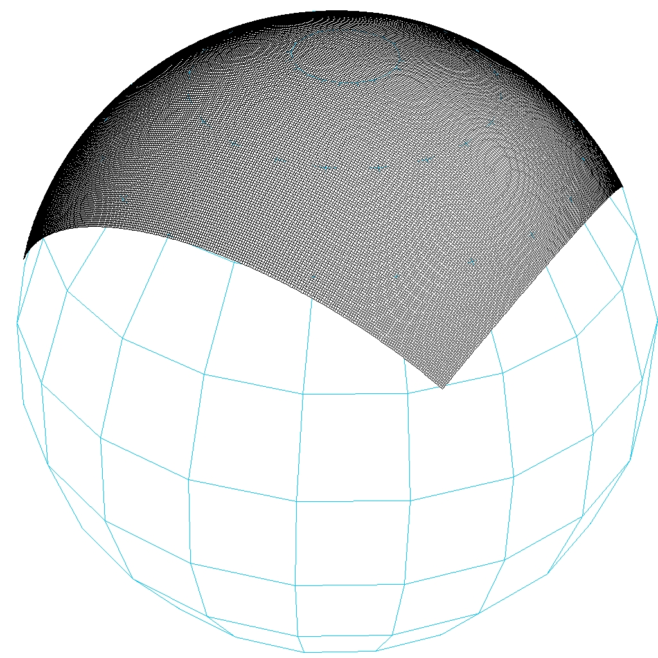
Community Data Management System (CDMS)
U
Use of ESMF regridder into CDMS
Irregular grid to regular grid
Create data provenance.
ESMF supported grids
Cubed Sphere Grid with Pentagons
Courtesy Mark Taylor of Sandia
FIM Unstructured Grid
Regional Grid
Figure from: NOAA - ESRL

Slide 10
Future work and benefits
Publish other project such as input4MIPs, obs4MIPs, ana4MIPs, GeoMIP, …
Each project needs to define a Control Vocabulary to use with PrePARE
Accelerate CDMS processing
Add Just-In-Time (JIT) compilation to CDMS
Add multiprocessing
Add parallel I/O
Update CDMS to Python 3
Create data provenance in ESGF
Connect CDMS with Compute Working Team (CWT) Effort
Add ESMF Cube-Sphere regridder support and documentation to CDMS
Update CDMS documentation

